Slide 1
Optimizing ElecKart’s OPERATIONS
PROJECT on
MARKET MIXED MODELLING
Capstone Project Submitted By:
Mansha Chhabra
Apoorva Nedunoori
Preeti Gupta
Enhancing Customer Experience and Driving Revenue Growth

Slide 2
AGENDA
1
5
BUSINESS OBJECTIVE
EXPLORATORY DATA ANALYSIS
2
ACTION PLAN
6
MODEL BUILDING AND EVALUATION
3
DATA PREPARATION
7
4
RECOMMENDATION AND KEY TAKEAWAYS
FEATURE ENGINEERING
– KPI’s Derived

Slide 3
Background
ElecKart is an e-commerce company based in Ontario, Canada, specializing in electronic products.
In the past year, they invested a significant amount of money in marketing and occasionally offered major promotions.
They are now preparing a marketing budget for the next year, which includes allocations for commercials, online campaigns, and pricing and promotion strategies.
The CFO believes that the previous year's marketing expenditure did not have the desired impact and is considering either reducing the budget or reallocating it strategically across different marketing channels to improve revenue response.

Slide 4
BUSINESS OBJECTIVE
The objective is to create a Market Mix Model specifically for ElecKart, an e-commerce company located in Ontario, Canada. The focus will be on three specific product sub-categories: Camera Accessories, Gaming Accessories, and Home Audio.
The purpose is to analyze the real impact of different marketing variables over a one-year period from July 2015 to June 2016. Based on the findings, recommendations will be provided for the optimal allocation of the budget across various marketing channels and strategies for the upcoming year.

Slide 5
ACTION PLAN
Performance Driver Analysis
KPIs impacting the top-line
performance
Impact Analysis on
Marketing ROI
Quantitative impact of each channel on revenue
Optimizing Marketing Spends
Recommendation to allocate the marketing budget to gain the highest outcome

Slide 6
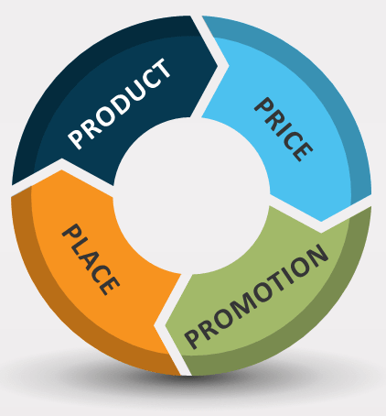
4 Ps OF MARKETING
# of units sold
Delivery days and SLAs
Categories/subcategories
Verticals Procurement SLA
GMV
Product MRP
We have the following datasets for analysis:
Consumer dataset: Contains daily order details of customers.
Media Investment dataset: Includes the amount invested in various advertising mediums over the past year.
Sale Calendar dataset: Displays the dates of promotional offers throughout the previous year.
NPS dataset: Provides the net promotion score and company stock value for the last year.
Weather dataset: Contains detailed weather reports from the state of Ontario, Canada, during the previous year.
Place
Promotion
Product
Pin code
Order Payment Type
Week of the year seasonality
Holiday/Events
Sale calendar
Marketing Channel Investments
Customer sentiment (NPS)
Ad stock

Slide 7
Nan value imputation: Replace missing values in delivery days and delivery days columns with zero.
Handling negative values: Convert negative values in certain columns such as delivery days and delivery days to their absolute values.
DATA PREPARATION
Removal of columns with single unique value: Columns that contain a single unique value and do not provide any meaningful information for the analysis were eliminated.
Removal of insignificant 'Id' columns: Certain 'Id' columns that are not relevant to the analysis were removed.
Incorrect Values in some columns
Removal of duplicate entries: We identified and removed duplicate entries from the dataset.
De-duplication of Data
Dropping records with SLA exceeding 30 days: Records where the Service Level Agreement (SLA) exceeded 30 days were dropped from the dataset.
Outlier capping of GMV: The Gross Merchandise Value (GMV) was capped at the 95th percentile to handle outliers.
Dropping Insignificant columns
Outlier Treatment
Removal of rows outside the specified timeframe: Rows that fell outside the specified timeframe were deleted.
Selection of data for analysis: Data from July 2015 to June 2016 was selected for the analysis.
Limiting the data for the year
Aggregating the data frames
Creation of separate data frames: Three distinct data frames were extracted for each of the product subcategories: camera accessory, home audio, and gaming accessory.
Aggregation of daily order data: The daily order data was rolled up to the weekly level by aggregating the numeric variables based on the week number.
Data scaling and log transformation: The data frame was scaled, and a log transformation was applied to certain variables where necessary.
Preparing the data for modelling

Slide 8
FEATURE ENGINEERING KPIs
DISCOUNT %
Discount % = (Product MRP - Selling Price)*100 / Product MRP
PRODUCT PREMIUMNESS
If GMV value is greater than 75 percentile, then luxury, else mass-market
LIST PRICE
List Price = GMV ( Gross Merchandise Value) * Units
Week #
Generate Week # column from the order date
PAYDAY WEEK
If Payday falls within the week, then payday week = 1, else 0
AD STOCK FEATURES
Calculate Ad Stock values for all Advertising media - Affiliates, SEM, Radio, Content Marketing, Online Marketing
HOLIDAY WEEK
If Holiday falls within the week, then payday week = 1,else 0
LAG VARIABLES
Lag variables(lag by 1, 2 & 3 days) for all KPIs can be taken for Distributive Lag Models

Slide 9

Exploratory Data Analysis – Insights

Slide 10
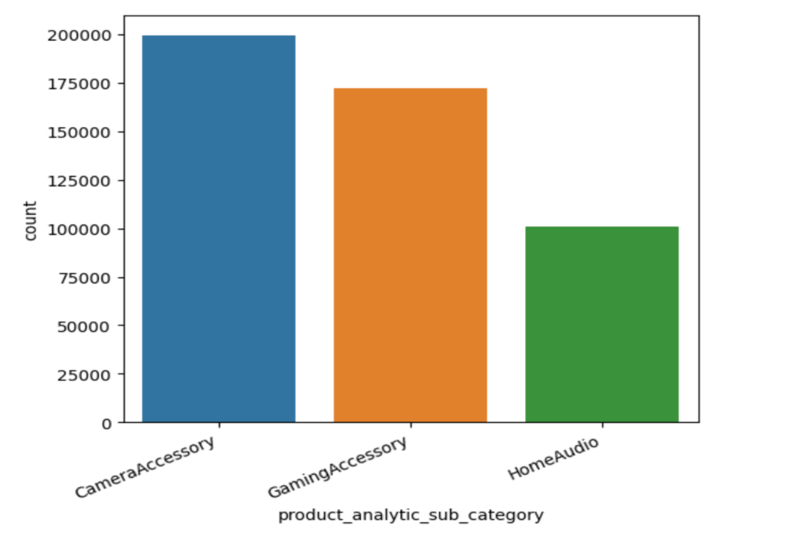
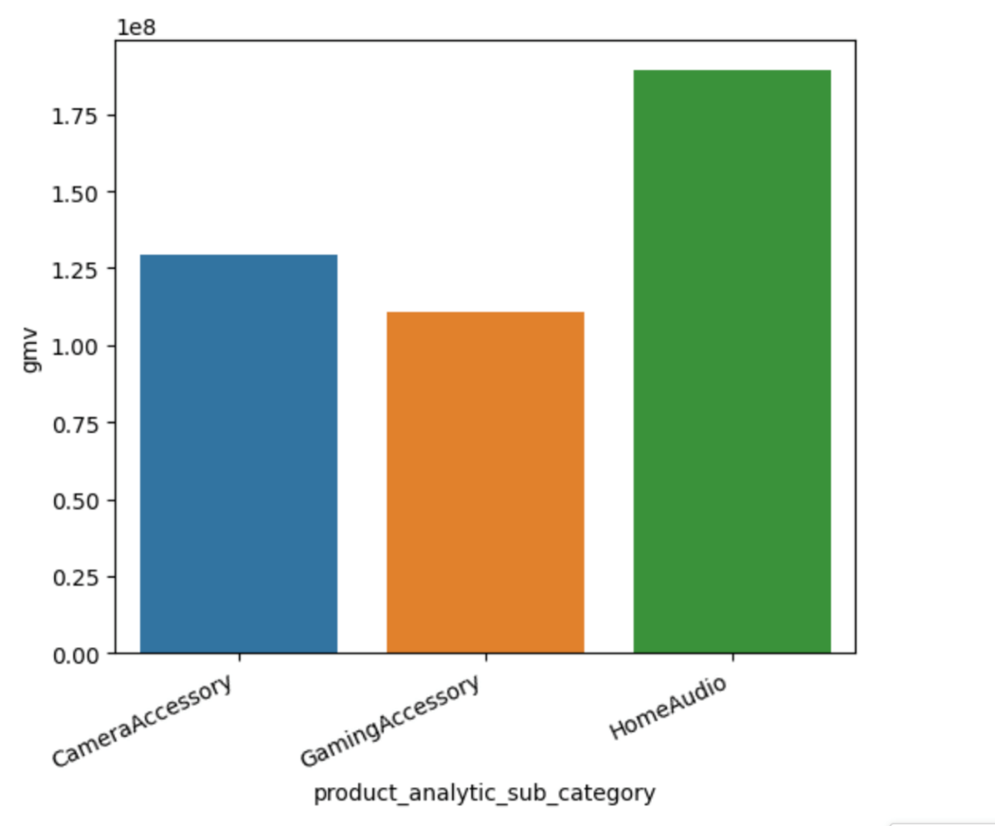
With respect to the count of orders, it has been observed that the Camera Accessory stands at the top followed by Gaming Accessory
Whereas, in terms of revenue(GMV), Home Audio stands at the top followed by Camera Accessory

Slide 11
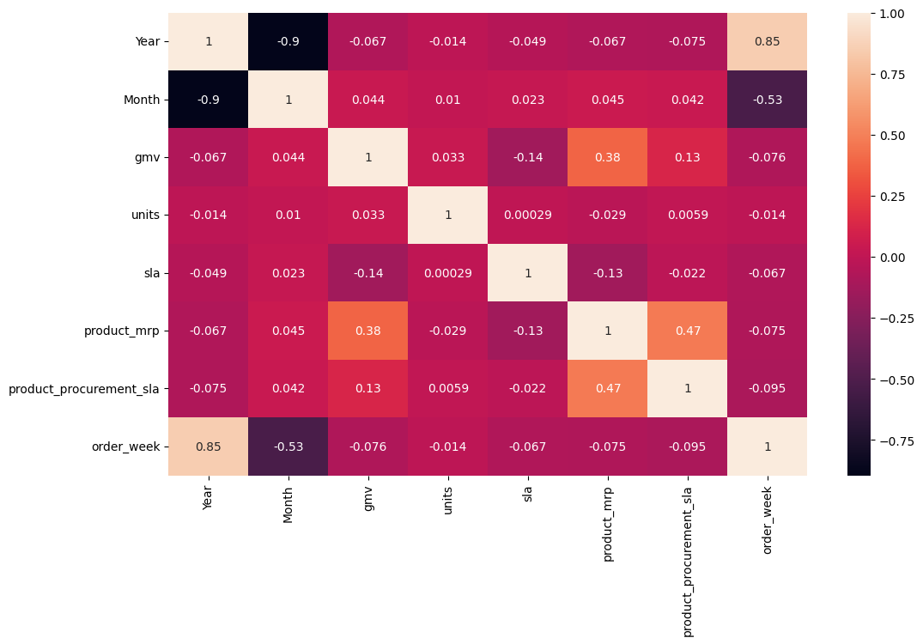
With the help of Correlation Matrix , we observed that there is a high correlation between: - Month & Year - order week & Year
There is also a moderate correlation between:
- product mrp & product procurement sla - GMV & product mrp

Slide 12
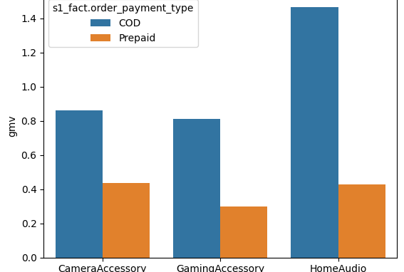
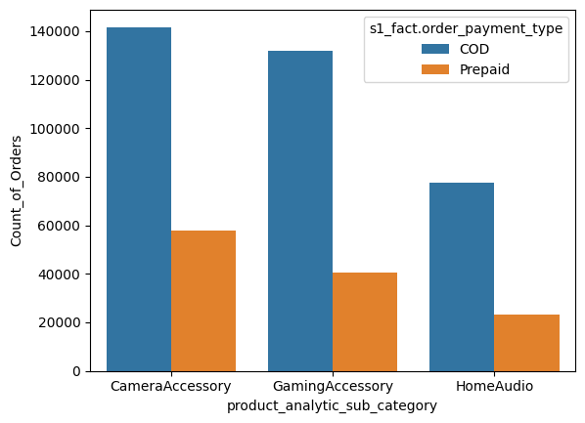
In terms of revenue, it was observed that the highest revenue was generated by the COD orders. And within COD orders, Home Audio followed by Camera Accessory had the higher revenue.
In the next observation it was found that the highest count of orders was generated from the Camera Accessory followed by Gaming Accessory for both the payment types

Slide 13
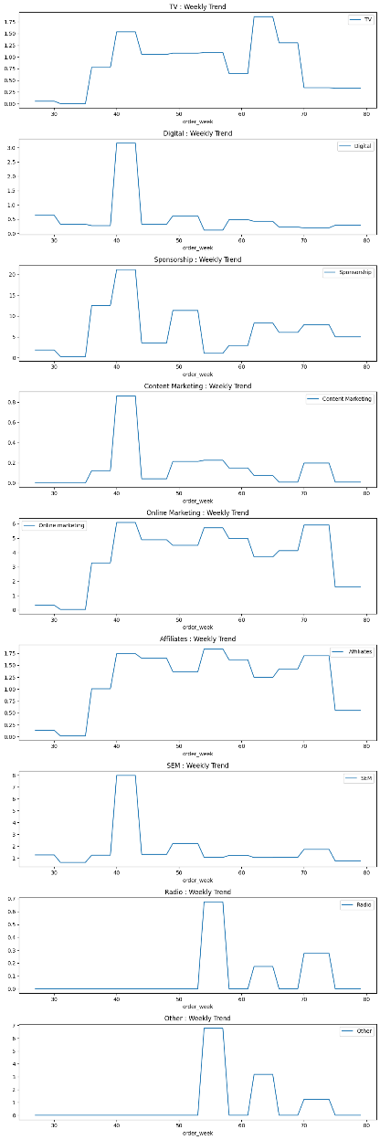
By analyzing the weekly spend over each channel, it was observed that between the weeks 39 to 45 for most of the channels, maximum amount of investments were done & that was done mainly through the Sponsorship Media.

Slide 14
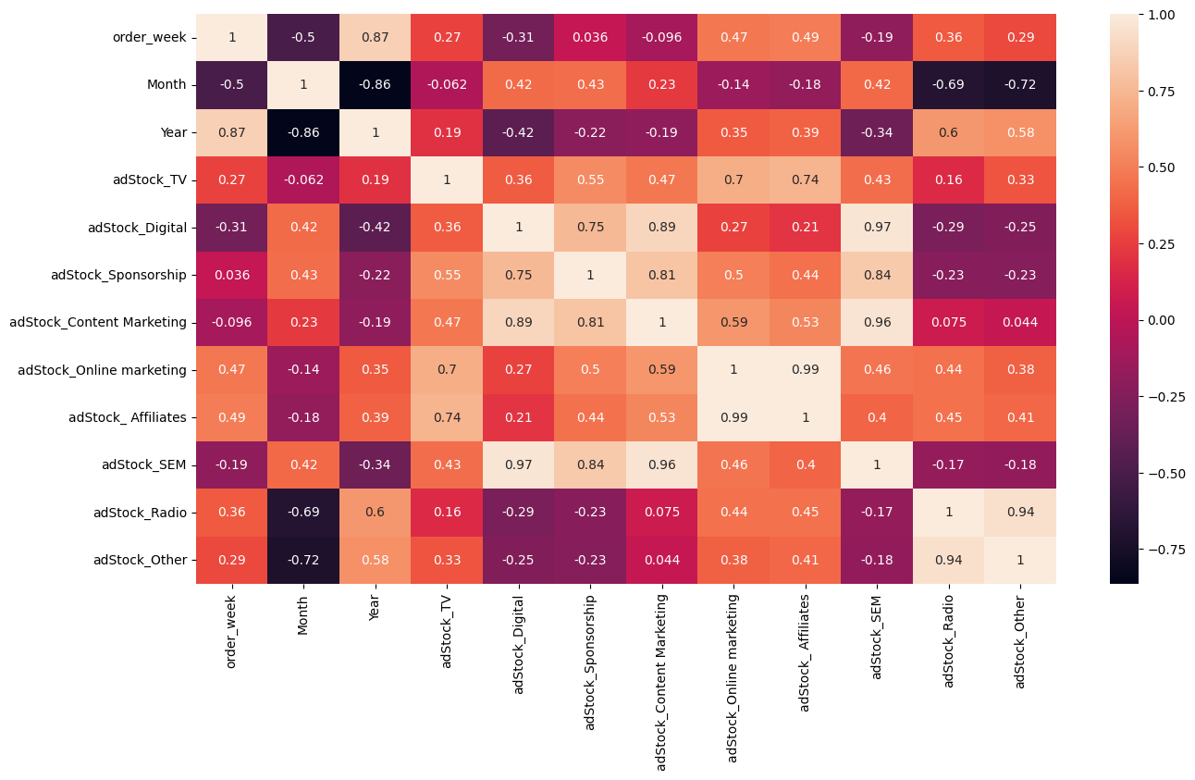
Out of the derived KPIs, with the help of Correlation Matrix it was observed that there is a high correlation between:
- adStock_Digital & adStock_SEM
- adStock_Content Marketing & adStock_SEM
- Month & adstock_radio; Month & adstock_others
- order_week & month; year & month
- adStock_Other & adStock_Radio
- adStock_Affiliates & adStock_Online marketing

Slide 15
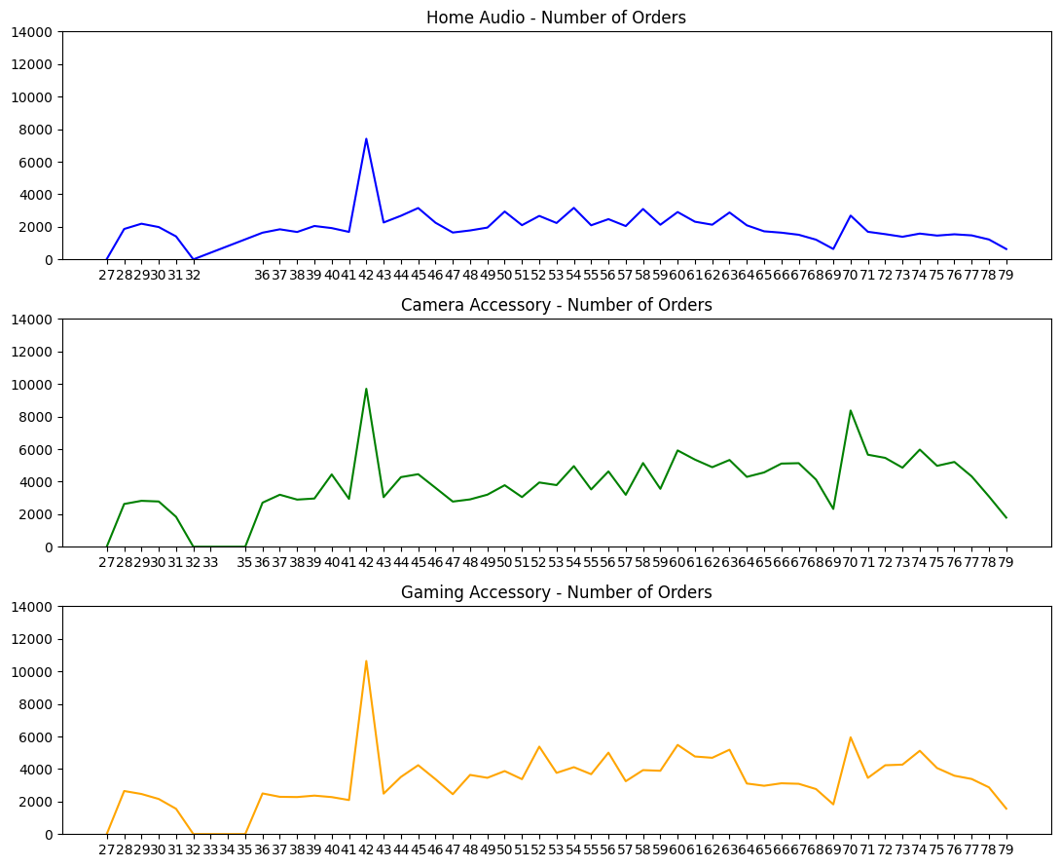
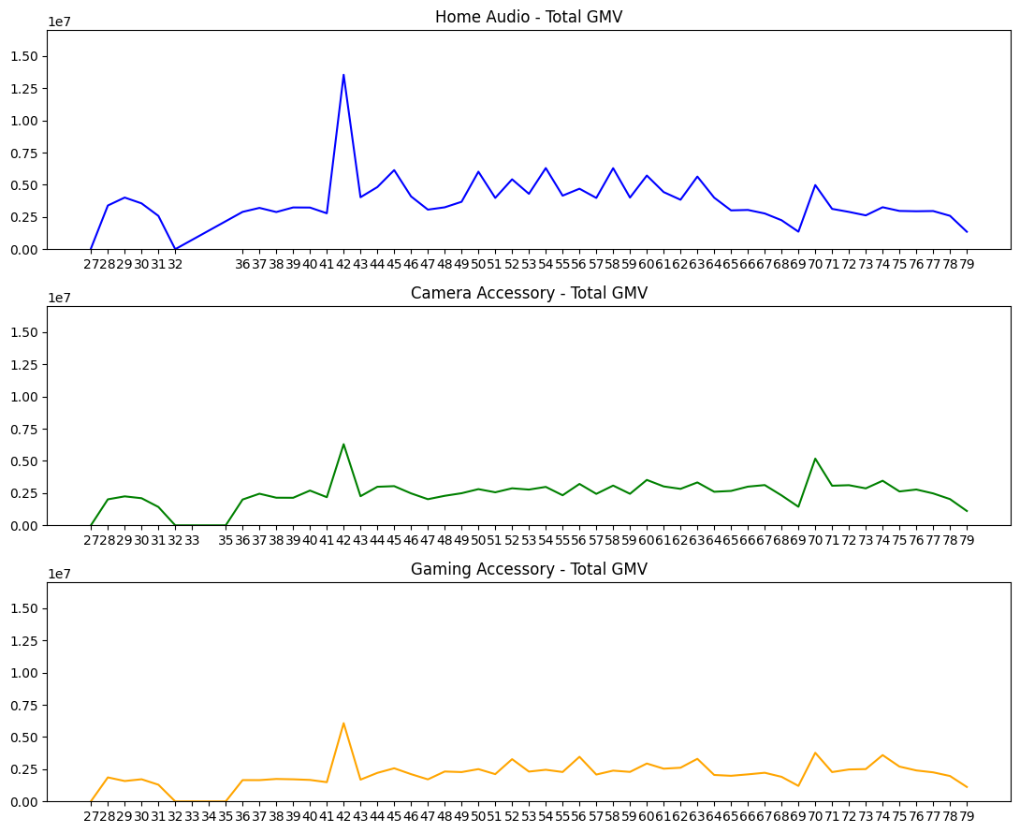
From the weekly trends, below were the major highlights: - Highest number of orders as well as the highest revenue was generated in week-42. - The maximum Revenue was generated for Home Audio followed by Camera Accessory.
- The highest count of orders were generated for Gaming Accessory.

Slide 16
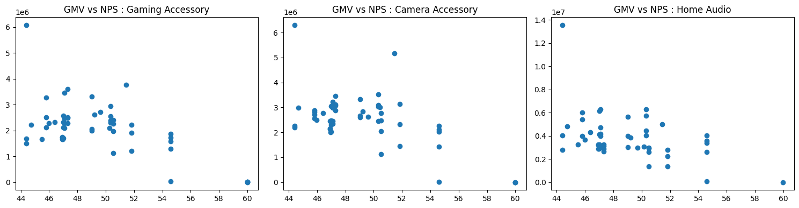
Finally, with the help of above scatterplot, we had observed that there is a negative correlation between the NPS & total sales(GMV) across all the product subcategories.

Slide 17
Model building and Evaluation

Slide 18
Model | Important Features | Accuracy (on test dataset)
Linear / Additive | 'adStock_Online marketing', 'Binoculars', 'CameraBattery', 'Filter', 'Strap | 96.08%
Multiplicative | discount', 'total_premiumn_products', 'CameraBag', 'CameraBatteryCharger', 'CameraBatteryGrip' | 99.93%
Distributed Lag | CameraAccessory', 'CameraBag', 'CameraBattery', 'CameraTripod', 'Flash', 'adStock_TV_lag2', 'adStock_Other_lag2', 'adStock_Other_lag3' | 97.04%
Camera Accessory Model

Slide 19
Model | Important Features | Accuracy (on test dataset)
Linear / Additive | 'adStock_TV’, 'GamePad', 'GamingHeadset', 'GamingMemoryCard', 'GamingMouse', 'JoystickGamingWheel', 'MotionController' | 98.25%
Multiplicative | 'GamingHeadset', 'JoystickGamingWheel' | 94.31%
Distributed Lag | 'GamePad', 'GamingHeadset', 'GamingKeyboard', 'GamingMemoryCard', 'GamingMouse', 'gmv_lag3', 'product_procurement_sla_lag1', 'NPS_lag3' | 96.76%
Gaming Accessory Model

Slide 20
Model | Important Features | Accuracy (on test dataset)
Linear / Additive | 'FMRadio', 'HomeAudioSpeaker', 'VoiceRecorder' | 99.34%
Multiplicative | 'sla', 'HomeAudioSpeaker', 'SoundMixer' | 99.40%
Distributed Lag | 'NPS', 'FMRadio', 'HomeAudioSpeaker', 'adStock_ Affiliates_lag3' | 99.17%
Home Audio
Model

Slide 21
Recommendations and Key Takeaways

Slide 22
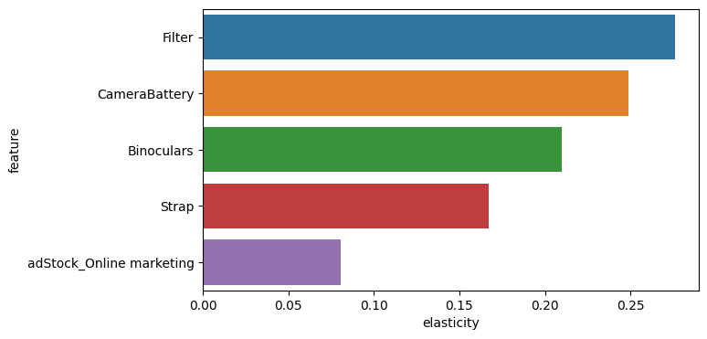
Camera Accessory Recommendations
Out of the various ML models that we have built, the Additive/Linear model fits best for the Camera Accessory.
Looking at the Elasticity of the key Features of the best fit model, below are the recommendations to the business:
- ElecKart should promote products like - Filter, Camera Battery, Binoculars & Strap as it has a very positive & incremental impact on the overall Revenue(GMV) growth.
- More marketing efforts should be spent on the promotion of Premium products.
- For marketing & products promotion, it’s a good idea to invest more in Online Marketing channels as it has shown a positive impact in boosting the overall revenue for the company.
- A slight increase in product discounts could also help to increase the sales marginally.
Elasticity with Additive Model

Slide 23
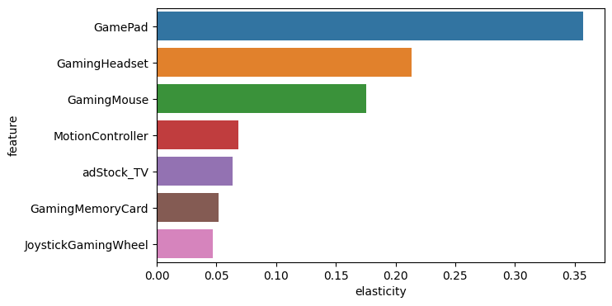
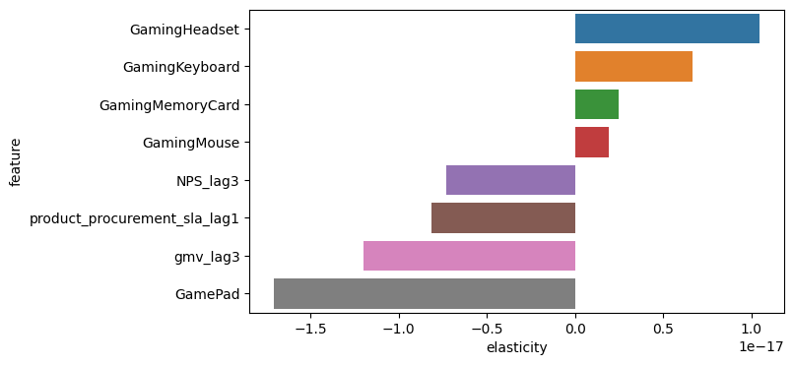
Gaming Accessory Recommendations
Out of the various ML models that we have built, the Additive/Linear model & the Distributed Lag model fits best for the Gaming Accessory .
Looking at the Elasticity of the key Features from both best fit models, below are the recommendations to the business:
- ElecKart should promote products like – GamePad, Gaming Headset, Gaming Mouse, Gaming Memory Cards & Accessory Kits as they fetch the highest revenue(GMV) for the company. .
- Marketing & Advertising spends on TV should be slightly increased as it has a positive impact on the revenue.
- An increase in NPS scores for the last 3 weeks has also contributed positively to the revenue growth of the business.
- Product Procurement SLA should be reduced for the last 1 week.
Elasticity with Additive Model
Elasticity with Distributive Lag Model

Slide 24
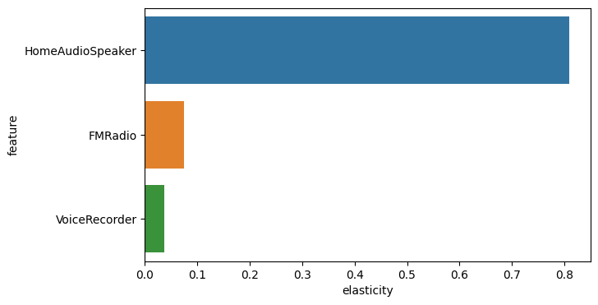
Home Audio Recommendations
Out of the various ML models that we have built, the Additive/Linear model fits best for the Home Audio.
Looking at the Elasticity of the key Features of the best fit model, below are the recommendations to the business:
- ElecKart should promote products like – Home Audio Speakers & FM Radio as they have shown a significant positive impact on revenue(GMV) growth (especially through the sale of Home Audio Speakers) of the company.
- Marketing & Advertising spends on Online Marketing channels for the last 3 weeks should be slightly increased as it can contribute to the revenue growth marginally. .
- Even if in case the SLA increases slightly, it hasn’t negatively affected the revenue growth for the business.
Elasticity with Additive Model

Slide 25
Thank you

